Slide 1
What is Software Design
is a mechanism to transform user requirements into some suitable form, which helps the programmer in software coding and implementation.
It deals with representing the client's requirement, as described in SRS (Software Requirement Specification) document, into a form, i.e., easily implementable using programming language.
moves the concentration from the problem domain to the solution domain.
In software design, we consider the system to be a set of components or modules with clearly defined behaviors & boundaries.

Slide 2
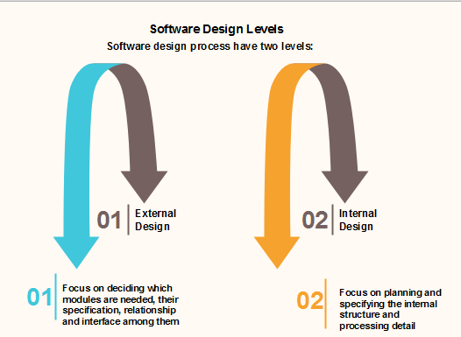
SW Design Level
Detail Level Design
High Level Design

Slide 3
Objectives of SW Design
.
01
06
Maintainability
should be so simple so that it can be easily maintainable by other designers.
Correctness
should be correct as per requirement
05
02
Completeness
should have all components like data structures, modules, and external interfaces, etc.
Consistency
There should not be any inconsistency in the design..
Efficiency
Resources should be used efficiently by the program.
Flexibility
Able to modify on changing needs.
04
03

Slide 4
Software Design Principles
Software design principles are concerned with providing means to handle the complexity of the design process effectively.
Effectively managing the complexity will not only reduce the effort needed for design but can also reduce the scope of introducing errors during design.
The key software design principles are:
SOLID
Pls check next Slide
DRY
Don’t Repeat Yourself
each small pieces of knowledge (code) may only occur exactly once in the entire system.
This helps us to write scalable, maintainable and reusable code.
YAGNI
KISS
You ain't gonna need it
always implement things when you actually need them
never implements things before you need them.
Keep it simple, Stupid!
keep each small piece of software simple
unnecessary complexity should be avoided.

Slide 5
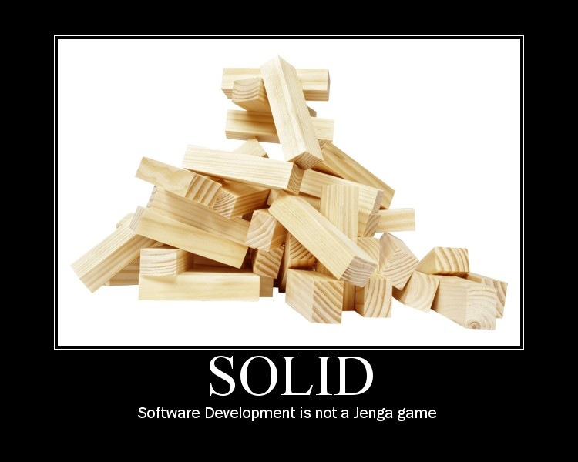

Software Design Principles - SOLID
In Object Oriented Programming (OOP), SOLID is an acronym, introduced by Michael Feathers, for five design principles used to make software design more understandable, flexible, and maintainable.
There are five SOLID principles:
Single Responsibility Principle (SRP)
Open Closed Principle (OCP)
Liskov Substitution Principle (LSP)
Interface Segregation Principle (ISP)
Dependency Inversion Principle (DIP)

Slide 6
Why SOLID
IMessageInfo
Retriever
IEmailSender
Email Sending App
EmailProcessingService
Flat File
Database
Database
Reader
Service
IMessage
Info
Retriever
File
XML File
IFileFormat Reader
FileReader
Service
EmailService
IEmail
Service
Without SOLID
Knowledge
With SOLID
Knowledge

Slide 7
Classes and Objects
A class is a template for objects.
A class defines object properties including a valid range of values, and a default value.
A class also describes object behavior.
An object is a member or an "instance" of a class.
An object has a state in which all of its properties have values that you either explicitly define or that are defined by default settings
Objects are generated by the classes and they actually contain values.
We design an application at the class level.

Slide 8
Encapsulation
The ability to protect some components of the object from external entities ("private").
Encapsulation is achieved when each object keeps its state private, inside a class.
Other objects don’t have direct access to this state. Instead, they can only call a list of public functions — called methods.
Each objects methods manage it’s own attributes.
This is also known as hiding.
An object A can learn about the values of attributes of another object B, only by invoking the corresponding method (message) associated to the object B.

Slide 9
Message Passing & Associations
Methods are associated with classes but classes don’t send messages to each other.
Objects send messages.
A static diagram (class diagram) shows classes and the logical associations between classes, it doesn´t show the movement of messages.
An association between two classes means that the objects of the two classes can send messages to each other.

Slide 10
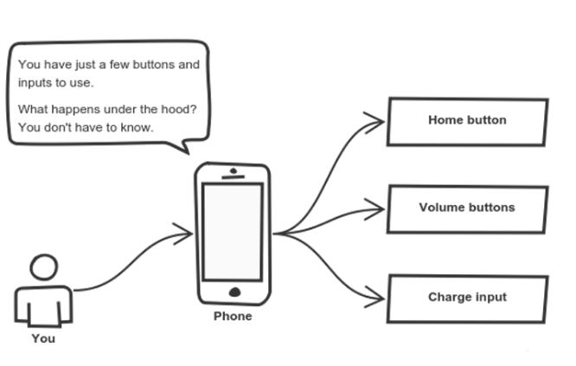
Abstraction
Abstraction can be thought of as a natural extension of encapsulation.
maintaining a large codebase for years — with changes along the way — is difficult.
Abstraction is a concept aiming to ease this problem.
Applying abstraction means that each object should only expose a high-level mechanism for using it.
This mechanism should hide internal implementation details. It should only reveal operations relevant for the other objects.
Think about your mobile again

Slide 11
Class Hierarchies & Inheritance
Objects are often very similar. They share common logic. But they’re not entirely the same
Every class, except Object, has a superclass
A class may have several ancestors, up to Object
When you define a class, you specify its superclass
If you don’t specify a superclass, Object is assumed
Every class may have one or more subclasses
Inheritance is important since it leads to the reusability of code.
Class hierarchy diagrams
Class: Chair
subclasses
Chair Type A
Chair Type B

Slide 12
More example
Container
Panel
ScrollPane
Window
Dialog
Frame
FileDialog
A FileDialog is a Dialog is a Window is a Container

Slide 13
Class Inheritance & Specialization
Class: Furniture
Attribute A1
Method A1
Class name
Attributes
Methods
Class: Chairs
[Attribute A1]
Attribute B1
[Method A1]
Method B1
Is a specialization of
Or
Inherits from
Class: Executive Chairs
[Attribute A1]
[Attribute B1]
Attribute C1
[Method A1]
Method B1 (B1 code modified)
Method C1

Slide 14
Public, Private & Protected
Attributes can be public or private:
Private: it can only be accessed by its own methods
Public: it can be modified by methods associated with any class
Methods can be public, private or protected:
Public: it’s name is exposed to other objects.
Private: it can’t be accessed by other objects, only internally
Protected: (special case) only subclasses that descend directly from a class that contains it, know and can use this method.

Slide 15
Polymorphism
Inheritance lets users inherit attributes and methods, and polymorphism uses these methods to perform different tasks.
Means that the same method will behave differently when it is applied to the objects of different classes

Slide 16
Let's take an example
Parent Class
Account
Deposit()
Withdraw()
Child Class
Savings
Current
Payroll
Withdraw()
The operation of deposit and withdraw is same for Savings and Current accounts. So the inherited methods from Account class will work. However the withdraw method need to be modified for payroll class.
when the "withdrawn" method for saving account is called a method from parent account class is executed.
But ,when the "Withdraw" method for the payroll account is called withdraw method defined in the privileged class is executed. This is Polymorphism in OOPs.

Slide 17
Method Overriding
Method Overriding is redefining a super class method in a sub class.
Rules for Method Overriding
The method signature i.e. method name, parameter list and return type have to match exactly.
The overridden method can widen the accessibility but not narrow it, i.e. if it is private in the base class, the child class can make it public but not vice versa.

